Slide 1
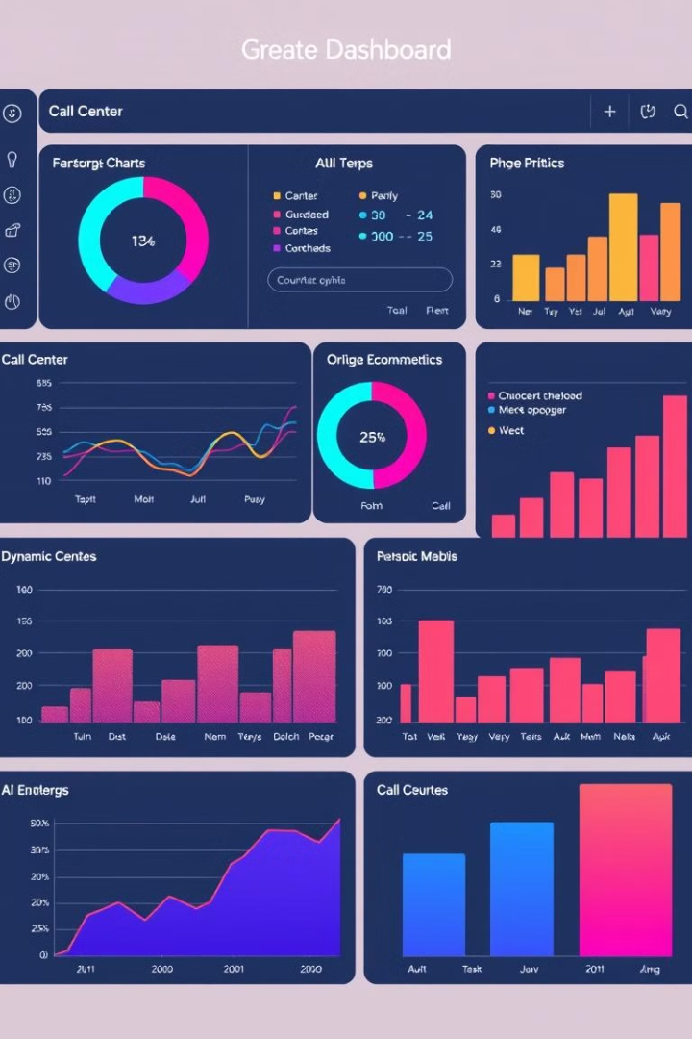
Power BI Dashboard for Call Center Trend Analysis
This presentation covers the key insights from the Power BI Dashboard. It focuses on agent performance, call resolution, and customer satisfaction. We will analyze trends and provide actionable recommendations. These insights will improve call center efficiency and customer experience.

Slide 2

Key Metrics Overview
67.52
Avg. Answer Speed
Seconds. Measures response time efficiency.
3.40
Avg. Satisfaction
On a scale of 5, indicating customer experience.
81.08%
Calls Answered
Percentage of calls successfully answered.
72.92%
Calls Resolved
Percentage of answered calls successfully resolved.

Slide 3
Top Agent Performance
Dan
Martha
Joe
Satisfaction rating: 3.45. Resolved calls: 471. A top performer.
Satisfaction rating: 3.47. Resolved calls: 461. Another top performer.
Satisfaction rating: 3.33. Resolved calls: 436. Needs improvement.

Slide 4

Call Resolution and Answer Rate
1
High Answer Rate
2
Resolution Gap
3
Action Needed
81.08% of calls are answered. Shows good accessibility.
Resolution rate is 72.92%. Some calls remain unresolved.
Analyze unresolved cases. Improve first-call resolution (FCR).

Slide 5




Response Time Impact
Becky & Dan
Faster response times lead to higher satisfaction.
Joe
Slower response time and lower satisfaction.
Key takeaway
Speed impacts customer experience significantly.

Slide 6
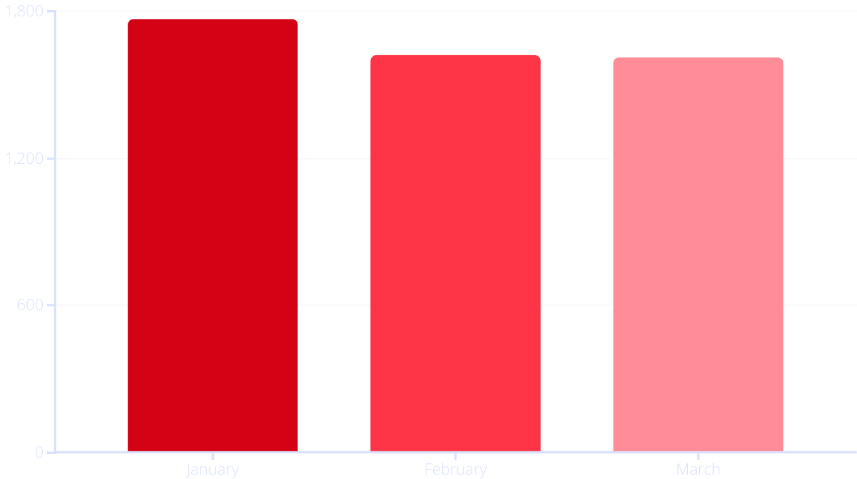
Call Trends Over Time
January had the highest call volume. There was a decline in February and March. Understand seasonality to plan staffing.

Slide 7




Improve Call Center Performance
Optimize Agent Training
Reduce Response Time
Customer Satisfaction
Share best practices. Provide soft skills training.
Auto-routing, AI chatbots for basic queries.
Post-call surveys to understand dissatisfaction reasons.

Slide 8

Key Takeaways & Next Steps
Agent Performance
Focus on training lower-performing agents.
Call Resolution
Improve first-call resolution rates.
Response Time
Minimize response times for better satisfaction.
Staffing
Adjust staffing based on call trends and seasonality.

Slide 9
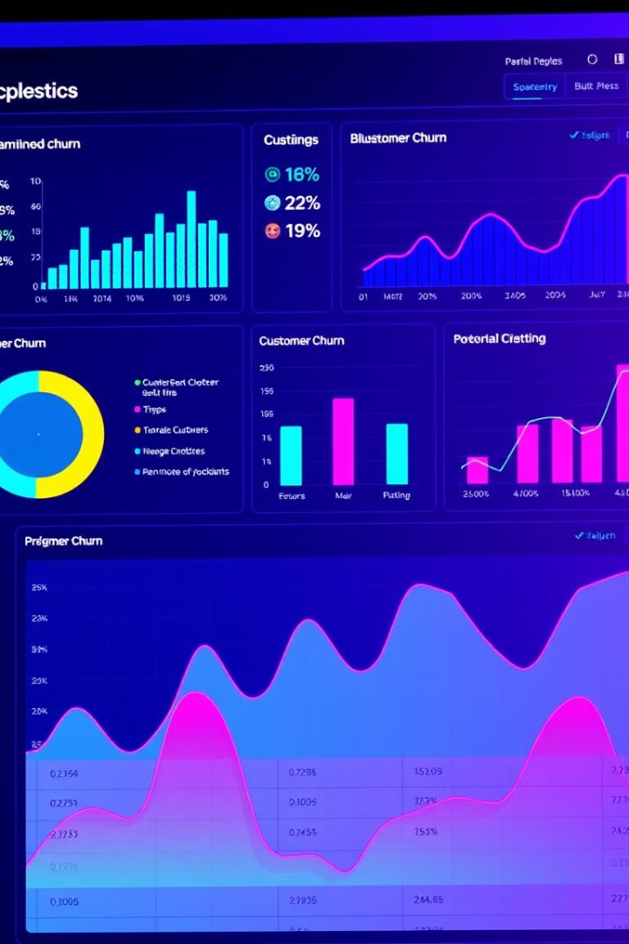
Customer Churn Exploratory Analysis
This presentation explores customer churn insights. It covers key metrics and demographics. Also included are subscription details and service usage. We aim to identify churn risk factors.

Slide 10

Key Churn Metrics Overview
1.9K
2.2K
Churned Customers
Tech Tickets
A significant number of customers churned.
High volume of technical support requests.
$2.9M
Annual Charges
Loss in revenue from churned customers.
The dashboard reveals critical churn indicators. Monitoring these metrics is crucial. It helps in understanding churn magnitude. Focus on addressing underlying issues.

Slide 11
Churn Demographics: Gender & Seniority
Gender Split
Senior Citizens
Subscription Length
Churn is almost equal between genders.
A quarter of churned customers were seniors.
Most customers churn within the first year.
Understanding demographics aids targeted interventions. Tailor retention strategies to specific groups. Consider age and subscription tenure.

Slide 12
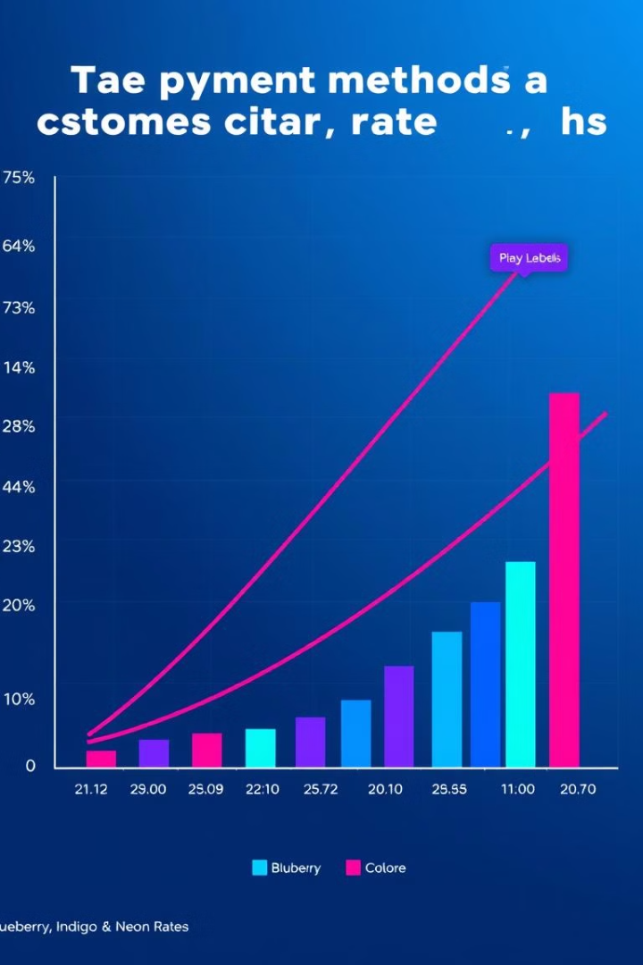
Account Information & Churn
Payment Methods
Paperless Billing
Electronic check is most common among churned.
High adoption, but doesn't prevent churn.
Contract Type
Month-to-month contracts show highest churn.
Account details provide actionable insights. Electronic checks may indicate dissatisfaction. Month-to-month contracts lack commitment.

Slide 13
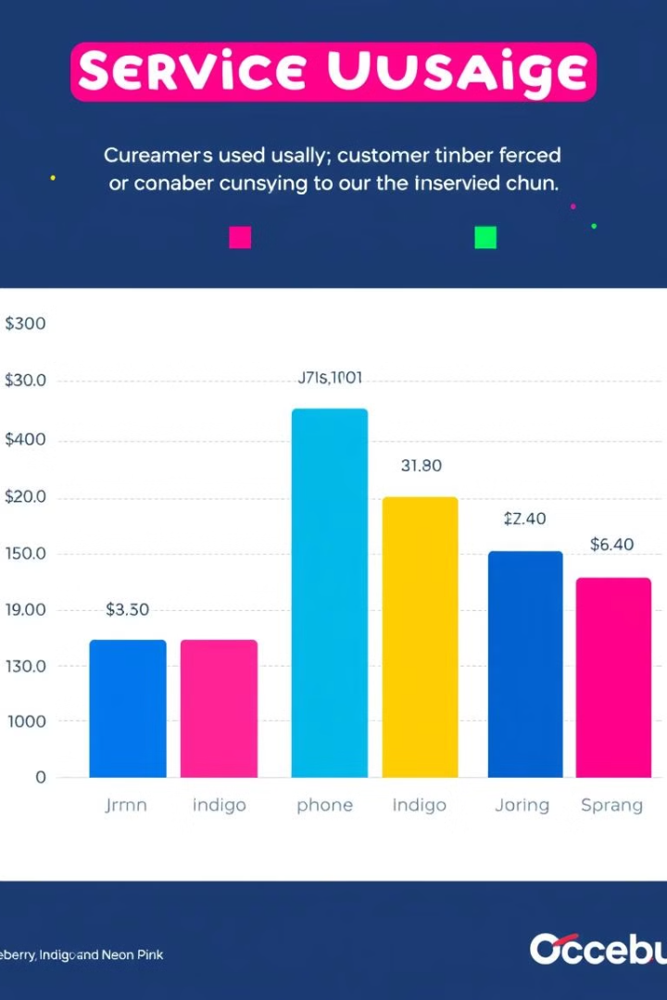



Service Subscriptions & Churn
Phone Service
Most churned customers had phone service.
Streaming Services
Significant number used streaming.
Internet Services
Fiber optic had highest churn rate.
Examine service usage patterns carefully. Identify pain points in fiber optic services. Streaming adoption may not guarantee retention.

Slide 14
Risk Analysis: Internet & Payment
Internet Churn
Annual Charges
Payment Churn
Fiber optic users show elevated churn rates.
Churned customers: $2.86M; non-churned: $13.19M.
Electronic check users have highest churn rate.
Focus on high-risk segments immediately. Prioritize fiber optic and electronic check users. Address potential service or billing issues.

Slide 15




Risk Analysis: Contract & Support
Contract Type
Subscription Length
Support Tickets
Month-to-month contracts drive churn.
More tickets suggest higher churn risk.
Short-term subscribers churn more.
Long-term contracts reduce churn significantly. Proactive support can mitigate churn risk. Engage subscribers early to boost retention.

Slide 16
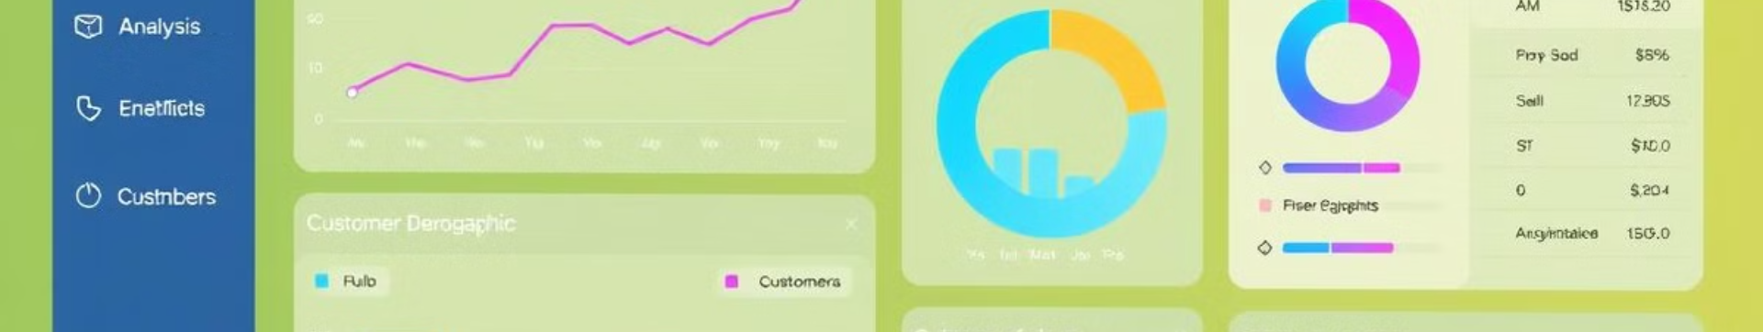
Key Churn Takeaways
1
Contracts & Payment
2
Subscription Length
Month-to-month & electronic checks increase churn.
Short-term subscribers have highest churn.
3
Fiber Optic
4
Support Tickets
Users churn more frequently.
Indicate higher churn risk.
Address contract and payment method issues. Improve fiber optic service satisfaction. Reduce support ticket volume proactively.

Slide 17
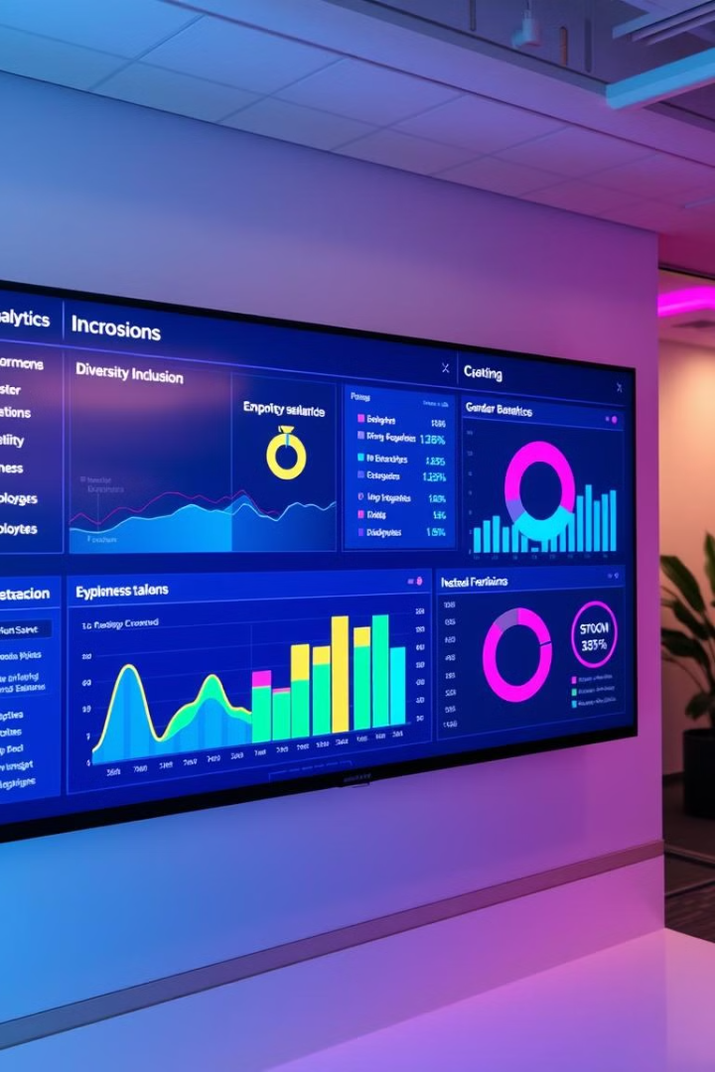
Diversity & Inclusion Analysis Dashboard
This presentation analyzes key Diversity & Inclusion (D&I) metrics. The insights are derived from a Power BI dashboard. The analysis covers hiring, promotions, turnover, and performance. It aims to help HR teams track D&I goals. The findings highlight areas for improvement in gender and age diversity.

Slide 18
Hiring History: Gender Distribution
Overall Hires
Job Level Distribution
41% of hires were women. 59% of hires were men. Hiring is still male dominated.
Junior roles show good balance. Higher roles have more men. This suggests a need to promote more women.

Slide 19
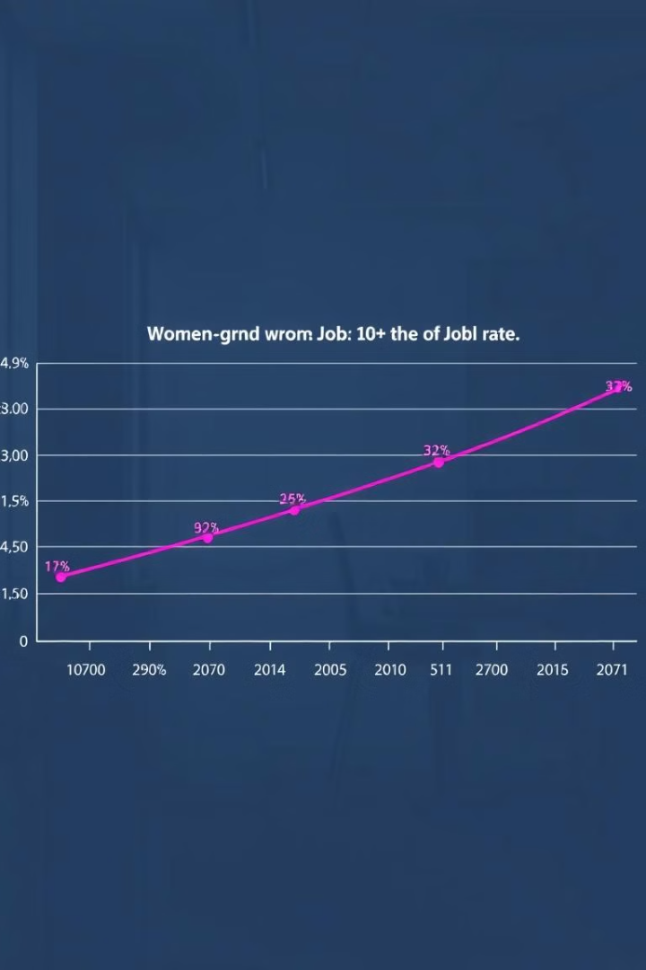
Promotion Trends: Gender Disparity
1
Promotion Rates
Female promotion rates vary by level. Some senior roles show female dominance.
2
Manager Roles
Manager roles show only 13% female promotions. This reveals a significant gender gap. Action is needed.

Slide 20
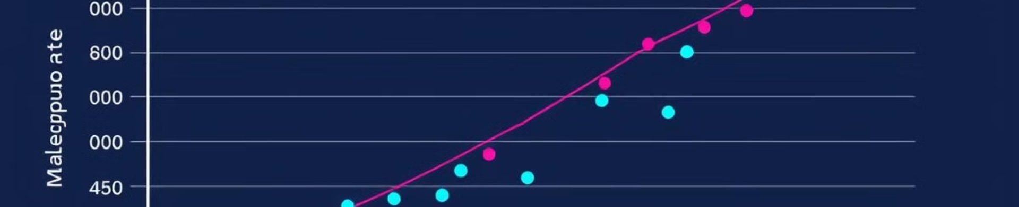
Turnover Rate Analysis
Overall Turnover
Gender-wise Trends
The overall turnover rate is 10.1%. Monitor to identify the cause.
Performance vs. turnover trends differ by gender. This suggests unique factors at play. More research needed.

Slide 21
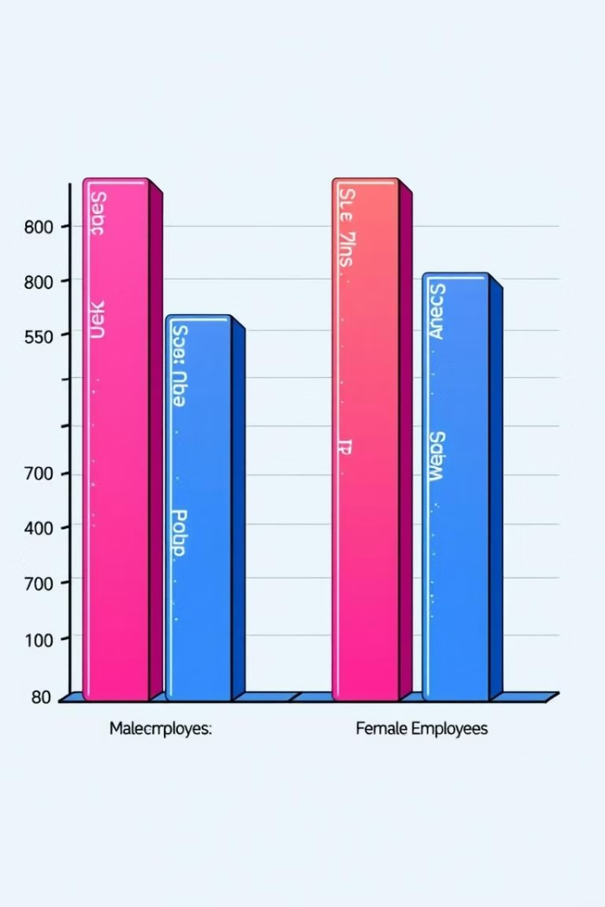


Performance Rating Comparison
Men's Average
Women's Average
Average rating for men: 2.41. Stable and consistent performance.
Average rating for women: 2.42. Nearly identical to men. Performance is consistent between genders.

Slide 22


Executive Gender Balance: A Gap
FY21 Improvement
FY20 Imbalance
1
15.8% female executives in FY21. Slight improvement, still not balanced.
12.5% female executives in FY20. Male dominance at the top.
2

Slide 23
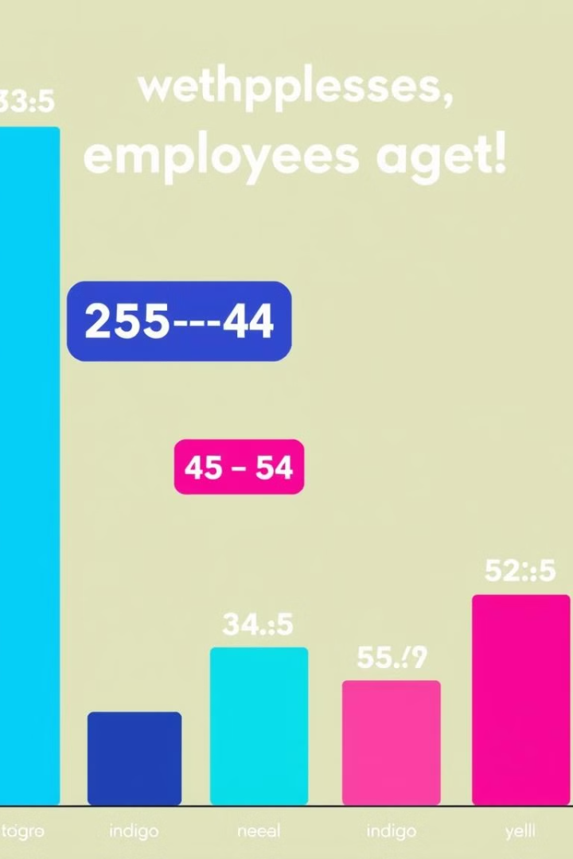


Age Group Distribution: Workforce Analysis
Dominant Group
223 employees are in the 20-29 age group. Younger workforce representation.
Age vs. Level
Age distribution varies across job levels. Insight into career progression.

Slide 24

Key Takeaways & Next Steps
1
Address Imbalance
2
Investigate Turnover
Promotions in leadership roles are male-dominated.
Turnover trends vary by job levels and gender.
3
Promote Diversity
Improve gender and age diversity in leadership.

